Slide 1
DataMining Project
EMNS - DataParis
Rym BARKAOUI
Mohamed SEFFAR
Manon FOULQUIER

Slide 2
Introduction
Client : EMNS
Spanish society specialized in international-questionnaire-sending
Subcontractor : Data-Paris
French society in data mining
Improve EMNS reports to one of its confidential client, studying questionnaires about technology product buyers

Slide 3
Summary
Steps
Goal 1
Goal 2
Goal 3

Slide 4
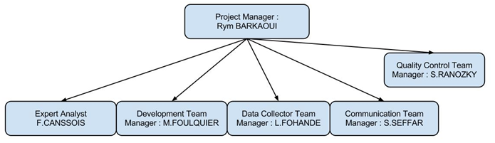
1. Steps
Team :

Slide 5
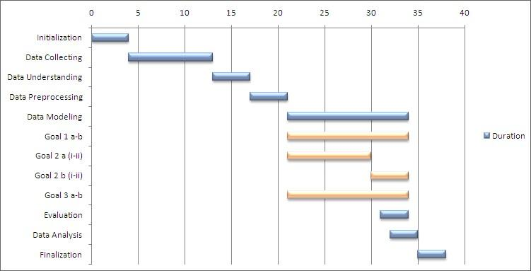
1. Steps
Planification :

Slide 6
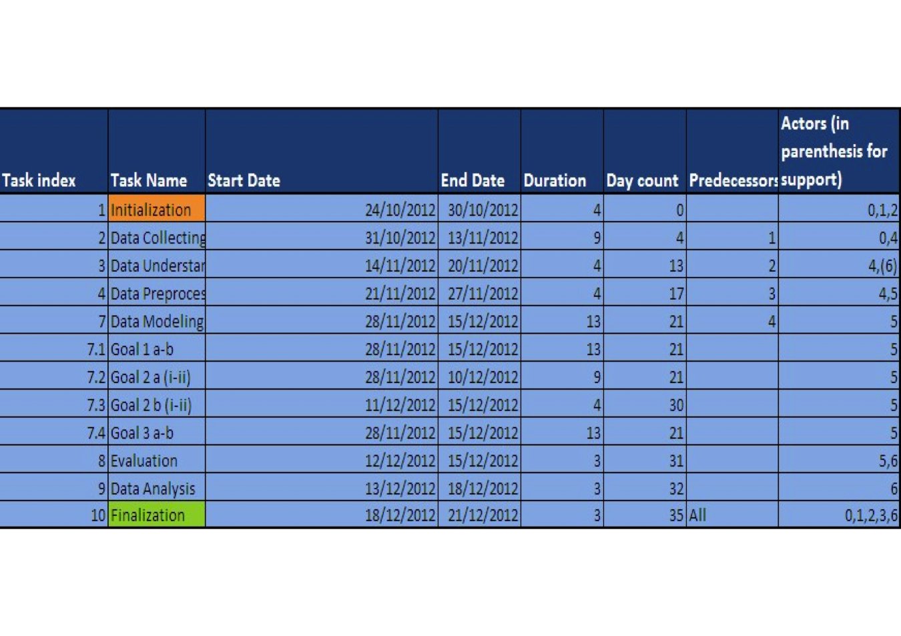
1.Steps
Gantt Diagram :

Slide 7
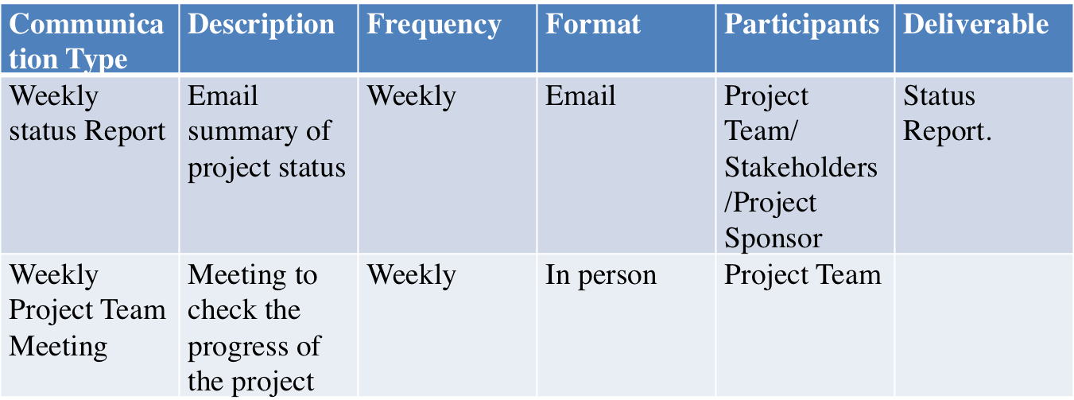
1.Steps
Communication Management Plan:

Slide 8
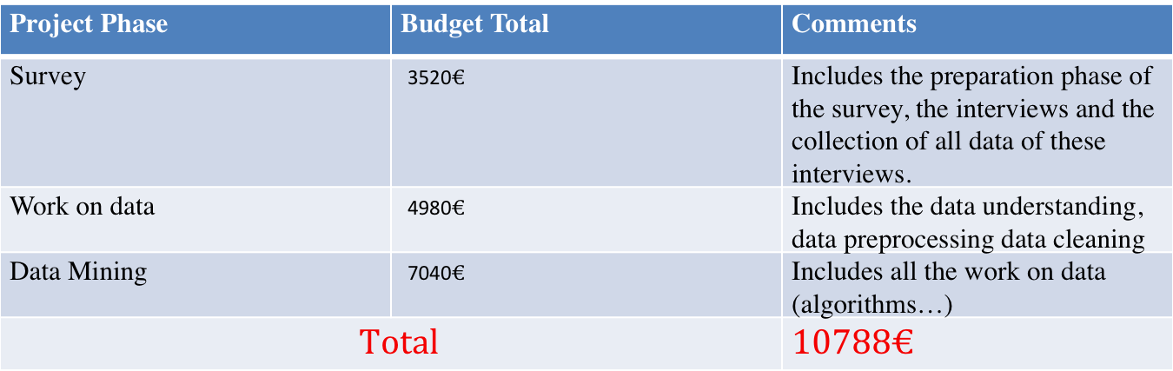
1.Steps
Costs:

Slide 9
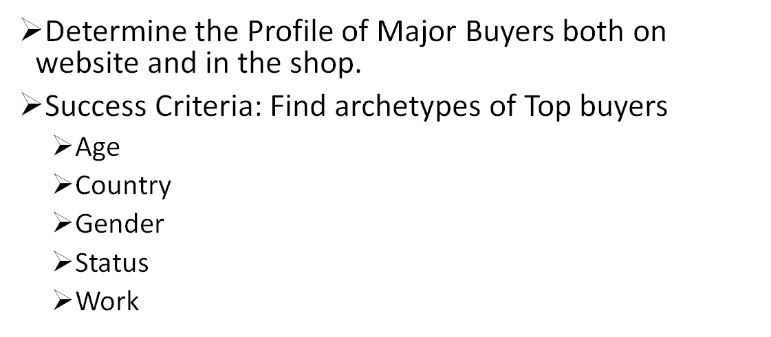
2. First Goal

Slide 10
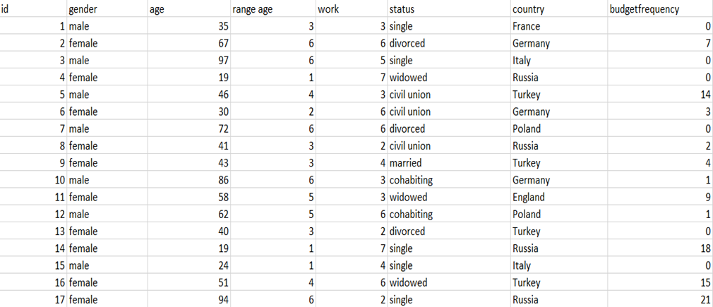
Dataset selected

Slide 11
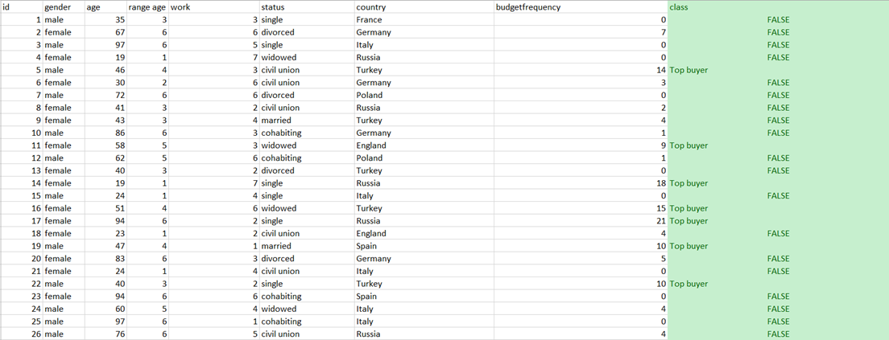
Dataset selected

Slide 12
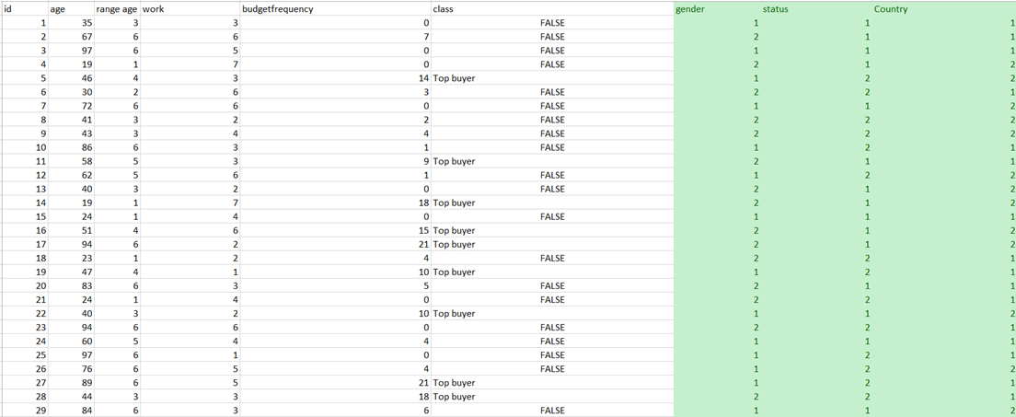
Dataset selected

Slide 13
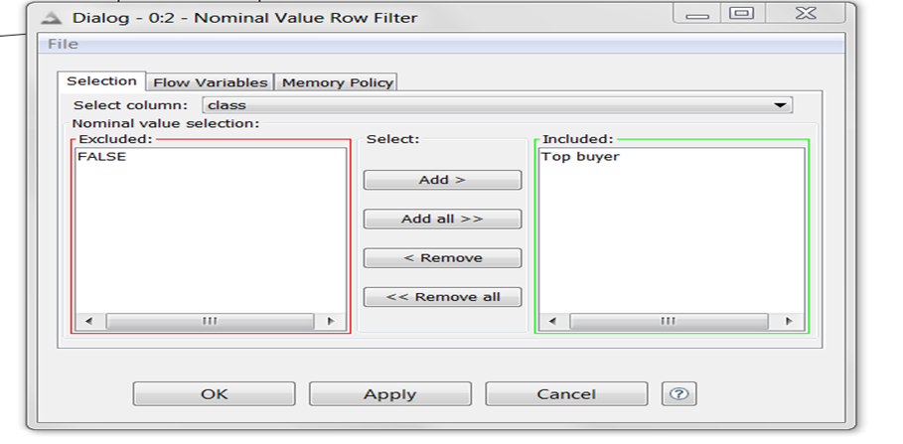
Dataset selected

Slide 14
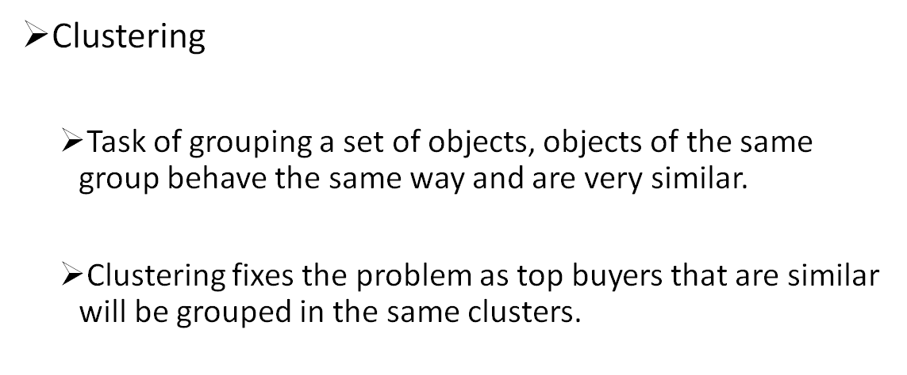
Technique Chosen

Slide 15
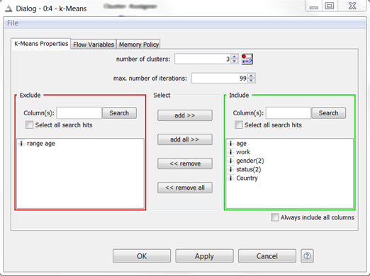
Algorithm chosen
1)- K-means
Configuration

Slide 16
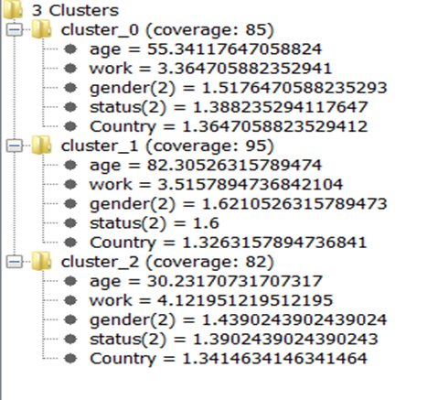
Results

Slide 17
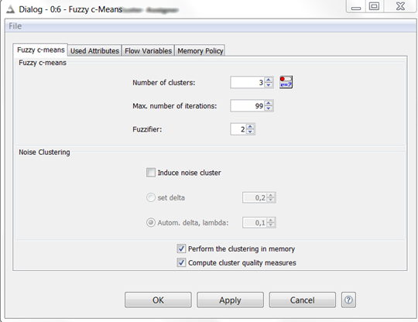
2)- Fuzzy C-means
Configuration

Slide 18
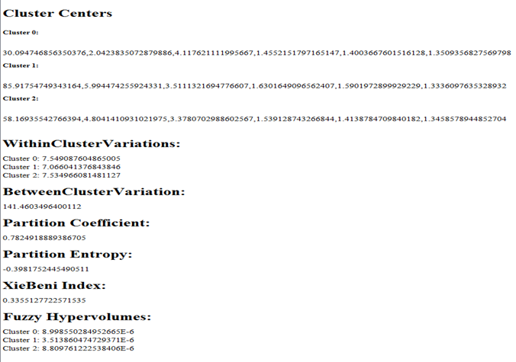
Results

Slide 19
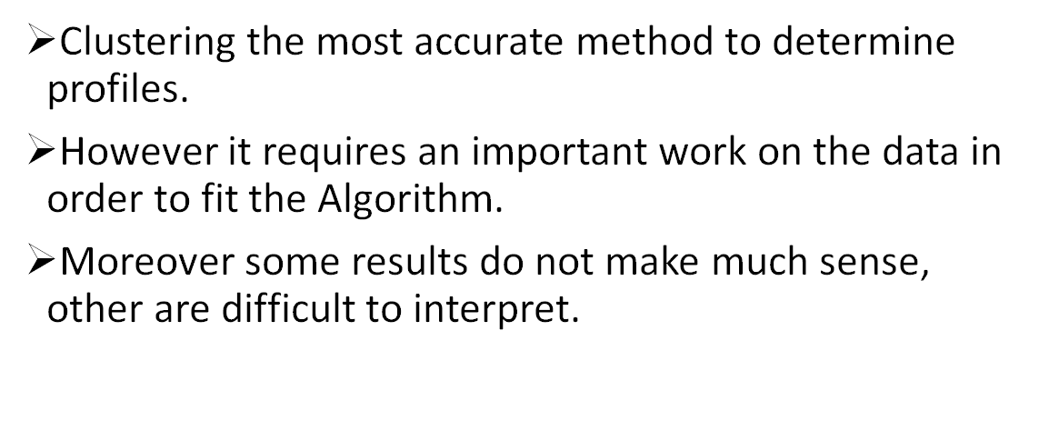
Analyse

Slide 20
3. Goal 2
Behavior of shoppers
Goal 2.a: general
Goal 2.a.i : For website
Goal 2.a.ii : For shop
Goal 2.b : by country
Goal 2.b.i : For website
Goal 2.b.ii : For shop

Slide 21


3. Goal 2
Dataset 2.a&b.i: For website
1000 entries
Attributes :
Dataset 2.a&b.ii: For shops
1000 entries
Attributes :

Slide 22
3. Goal 2
a. Techniques
b. Algorithms
c. Execution
Configuration
Results
Problems

Slide 23
3.a Techniques
Goal 2.a : Behavior of shoppers, general
Clustering
Association
Goal 2.b : Behavior of shoppers, by country
Classification
Clustering

Slide 24
3.b Algorithms
Goal 2.a : Behavior of shoppers, general
Clustering
Hierarchical Clustering
Fuzzy C-Means
Association > no result
Goal 2.b : Behavior of shoppers, by country
Classification
Naive Bayes
Clustering
K-means

Slide 25
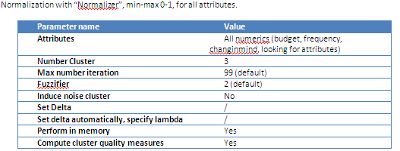
3.c Execution
Goal 2.a.i : Behavior of shoppers for website
Technique : Clustering
Algo : Fuzzy C-Means
Configuration :

Slide 26

3.c Execution
Goal 2.a.i : Behavior of shoppers for website
Result:

Slide 27
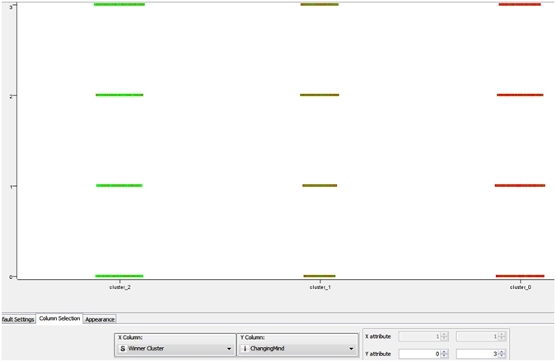
3.c Execution
Goal 2.a.i : Behavior of shoppers for website
Result: ChangingMind = f(cluster)
Red for lowest budget, Green for highest

Slide 28
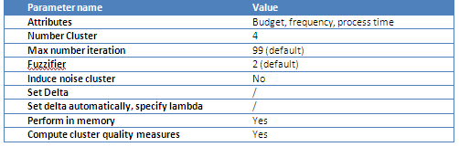
3.c Execution
Goal 2.a.ii : Behavior of shoppers for shops
Technique : Clustering
Algo : Fuzzy C-Means
Configuration :

Slide 29
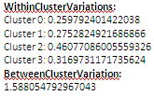
3.c Execution
Goal 2.a.ii : Behavior of shoppers for shops
Result:

Slide 30
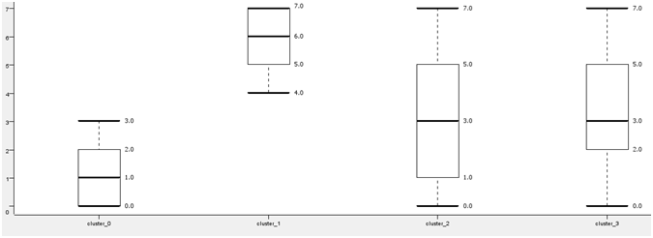
3.c Execution
Goal 2.a.ii : Behavior of shoppers for shops
Result: Budget by cluster

Slide 31
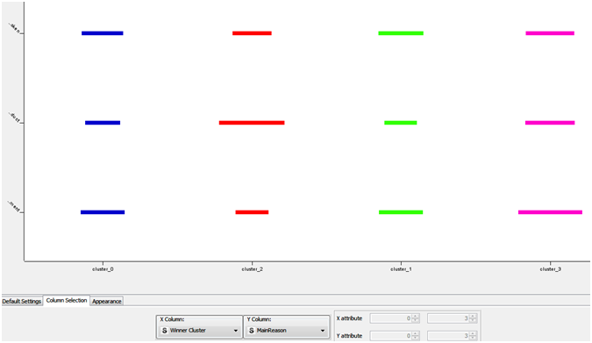
3.c Execution
Goal 2.a.ii : Behavior of shoppers for shops
Result: Main Reason = f(cluster)
(from top to down:
Previous is broken/ Update previous product / New requirement)

Slide 32
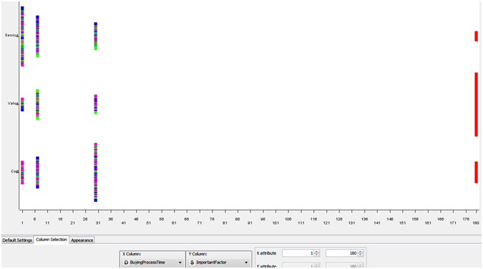
3.c Execution
Goal 2.a.ii : Behavior of shoppers for shops
Result: · ImportantFactor = f(Buying Process Time), cluster colored
(cluster 0 blue / cluster 1 green / cluster 2 red / cluster 3 pink)

Slide 33

3.c Execution
Goal 2.b.i : Behavior of shoppers for website, by country
Technique : Clustering
Algo : K-Means
Configuration : selection country

Slide 34
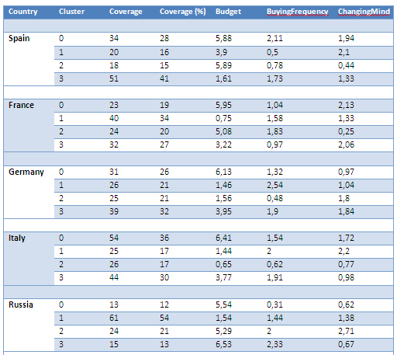
3.c Execution
Goal 2.b.i : Behavior of shoppers for website, by country
Result:

Slide 35
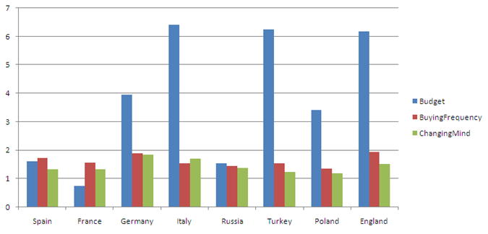
3.c Execution
Goal 2.b.i : Behavior of shoppers for website, by country
Result: Cluster with the highest coverage for each country

Slide 36

3.c Execution
Goal 2.b.ii : Behavior of shoppers for shops, by country
Technique : Clustering
Algo : K-Means
Configuration : selection country

Slide 37
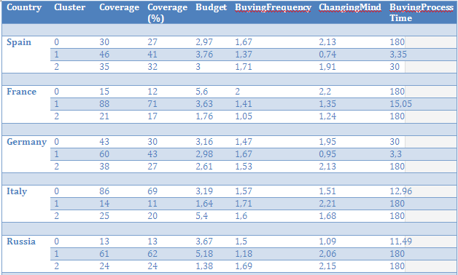
3.c Execution
Goal 2.b.ii : Behavior of shoppers for shops, by country
Result:

Slide 38
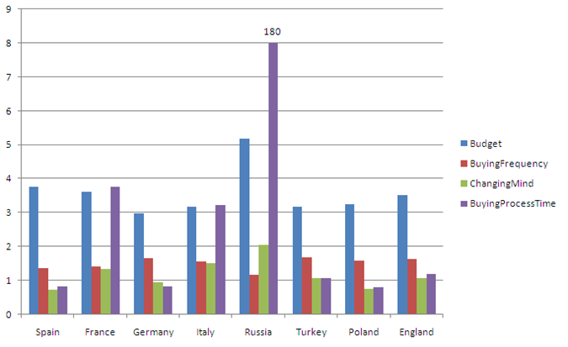
3.c Execution
Goal 2.b.ii : Behavior of shoppers for shops, by country
Result: Cluster with the highest coverage for each country

Slide 39
4. Goal 3
Aim:
Find the profile of customers who consider that there are other factors more important
Technique Chosen :
Decision Tree
Algorithm Chosen:
Reptree

Slide 40
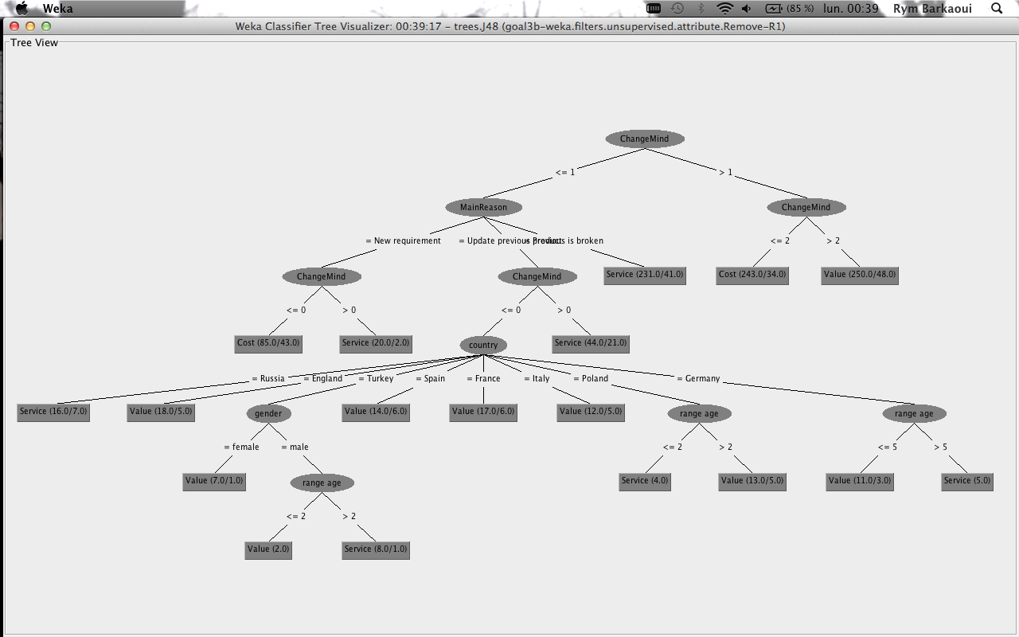

Slide 41
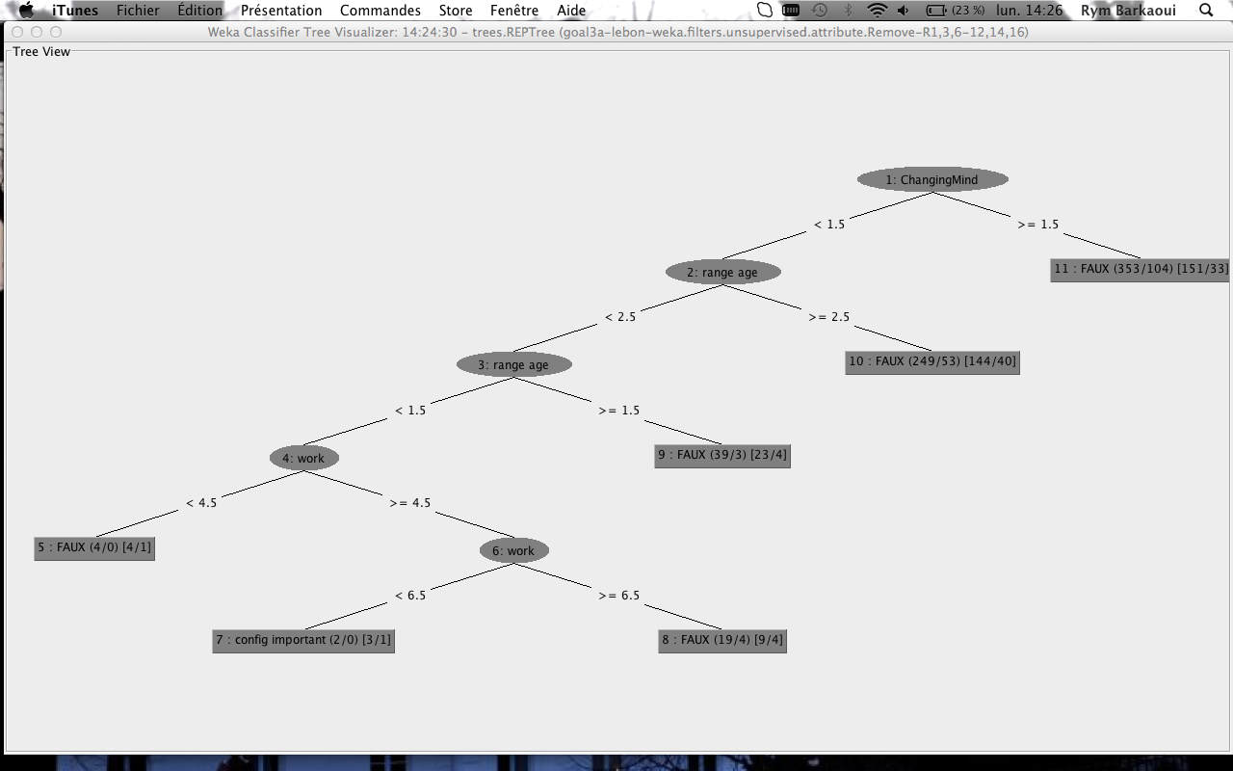
•Change their mind very rarely,
•Less than 35 years old,
•Employees, workers or students.

Slide 42
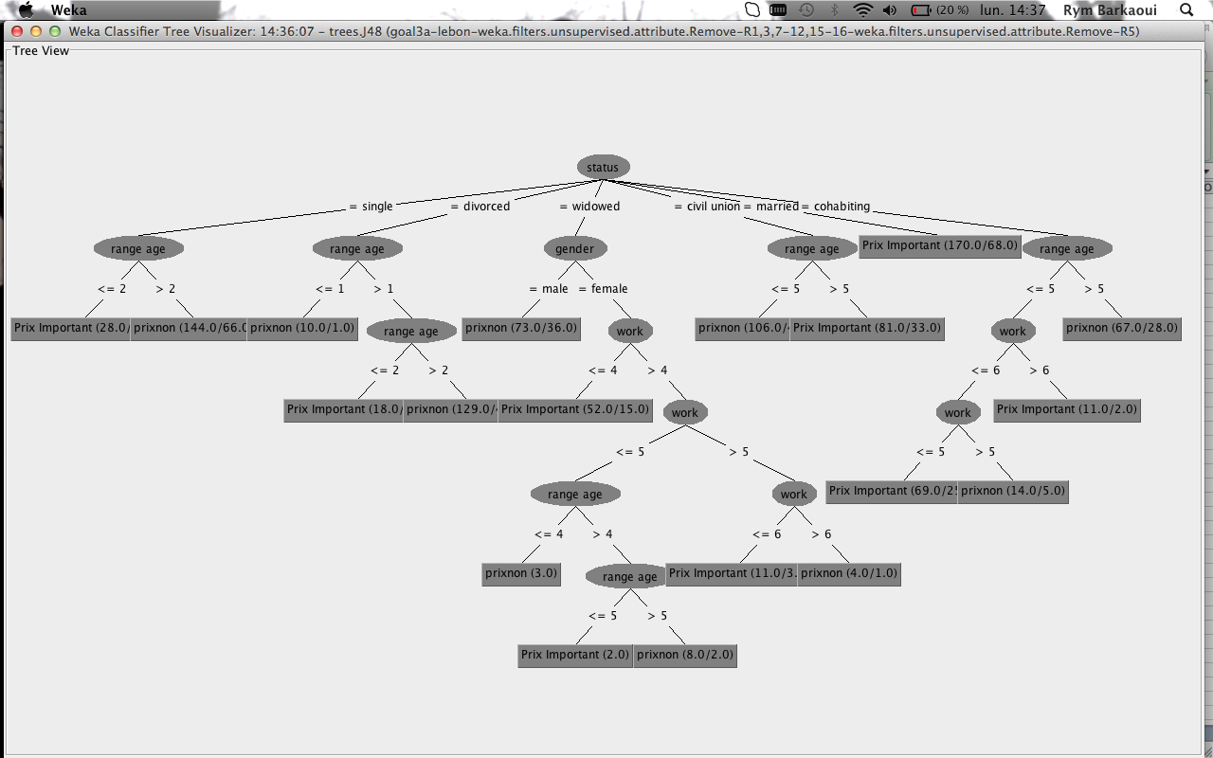

Slide 43
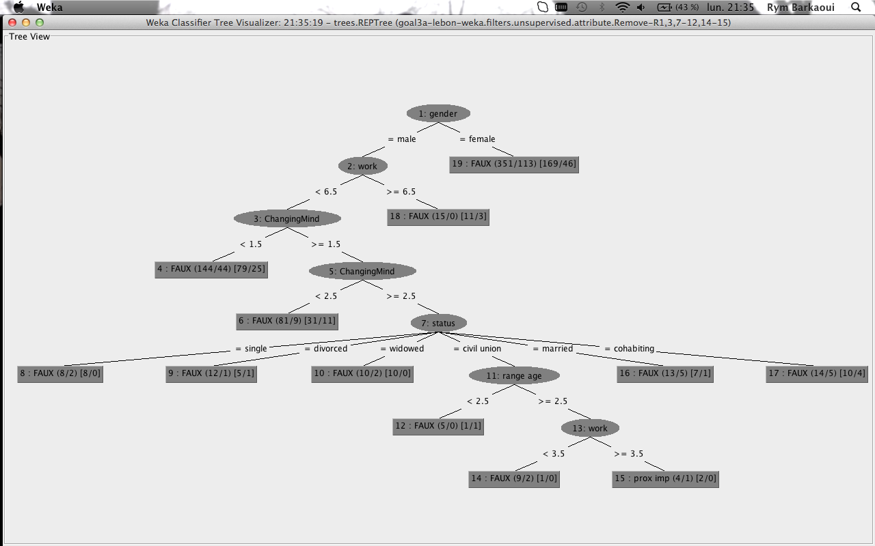
•male
•workers or employees or doing intermediary professions,
•changing their mind very frequently,
•living in a civil union,
•more than 40 years old.

Slide 44
Conclusion
> EMNS came to us so we could extract useful information out of their questionnaires.
> After a clear project plan a big work on data and some mining techniques we managed to extract information that could be very useful for the computer company in order to boost their sales.

